Slide 1
COVID-19 Update: Issues Facing the Workplace
February 22, 2022

Slide 2
Disclaimer
The materials contained in this presentation were created by Laddey, Clark & Ryan, LLP, for informational purposes only and are not intended and should not be construed as a substitute for legal advice.
This seminar is not intended to create an attorney-client relationship between you and Laddey, Clark & Ryan, LLP.
This seminar is not intended to serve as an advertisement or solicitation.
All materials in this seminar are copyrighted © 2021 Laddey, Clark & Ryan, LLP.
The reproduction of any materials contained in this seminar without the permission of Laddey, Clark & Ryan, LLP, is prohibited.

Slide 3
While we hope to move from a pandemic to an epidemic, there are still many employment decisions to be addressed.
Employee absences – for vaccine, COVID exposure/illness and family needs
Paid leave
Job protections
Return to work
Vaccinations
Mandates
Inquiries
Exemptions

Slide 5
Absences due to COVID-19
Need to consider
New Jersey Paid Sick Leave Law
Family and Medical Leave Act (FMLA)
New Jersey Family Leave Act (NJFLA)
Disability Leave
Family Leave Insurance
Workers Compensation Insurance

Slide 6
To receive payments from Unemployment, Temporary Disability, and Family Leave Insurance due to COVID absences, one must apply through the New Jersey Department of Labor (NJDL).
FMLA and NJFLA are UNPAID leave, that require an application to the employer.
NJ Paid Sick Leave is provided directly by employers.
A claim for Workers Compensation coverage must be filed by the employee through the Workers Compensation carrier.

Slide 7
If an individual is unable to work because they are getting the COVID-19 vaccine or are recovering from side effects, they:
Can use accrued Earned Sick Leave
NJ employers must provide full-time, part-time, and temporary employees with up to 40 hours of paid sick leave per year.
Can be used to care for themselves or a loved one, including for COVID-19 testing, illness, quarantine, or vaccination.
Can also use earned sick leave to travel to and from a vaccine appointment and recover from side effects, as well.

Slide 8
If an individual has tested positive for COVID-19, or has symptoms of COVID-19 and is unable to work, they:
Cannot be discriminated against.
Under the New Jersey Law Against Discrimination, employees are protected from discrimination and harassment based on actual or perceived disability.
Disability is defined as, among other things, any “physical … infirmity … which is caused by … illness …”.
COVID-19 is an infectious disease caused by a newly discovered coronavirus, and would constitute an illness.
Any physical infirmity caused by COVID-19 qualifies as a disability under the law.

Slide 9
An employer must provide reasonable accommodations to the employee unless doing so would impose an undue hardship on the employer’s operations. (Enforced by the NJ Division on Civil Rights)
Accommodations could include telework or time off from work.

Slide 10
If an individual has tested positive for COVID-19, or has symptoms of COVID-19 and is unable to work, they:
Can use accrued Earned Sick Leave
NJ employers of all sizes must provide full-time, part-time, and temporary employees with up to 40 hours of paid sick leave per year.
Can use unpaid leave
FMLA
Employer’s unpaid leave policy

Slide 11
Wage Replacement Benefits
Temporary Disability Insurance (TDI) benefits
A claim must be filed online at myleavebenenfits.nj.gov.
The health care provider provides the diagnosis and the duration the individual is expected to be out of work.
Wage records available to NJDOL determine the amount of TDI benefits.
It is against the law for employers to retaliate against employees for taking or seeking to take TDI benefits.
In addition, some NJ workers are eligible for job-protected medical leave under the Federal FMLA.

Slide 12
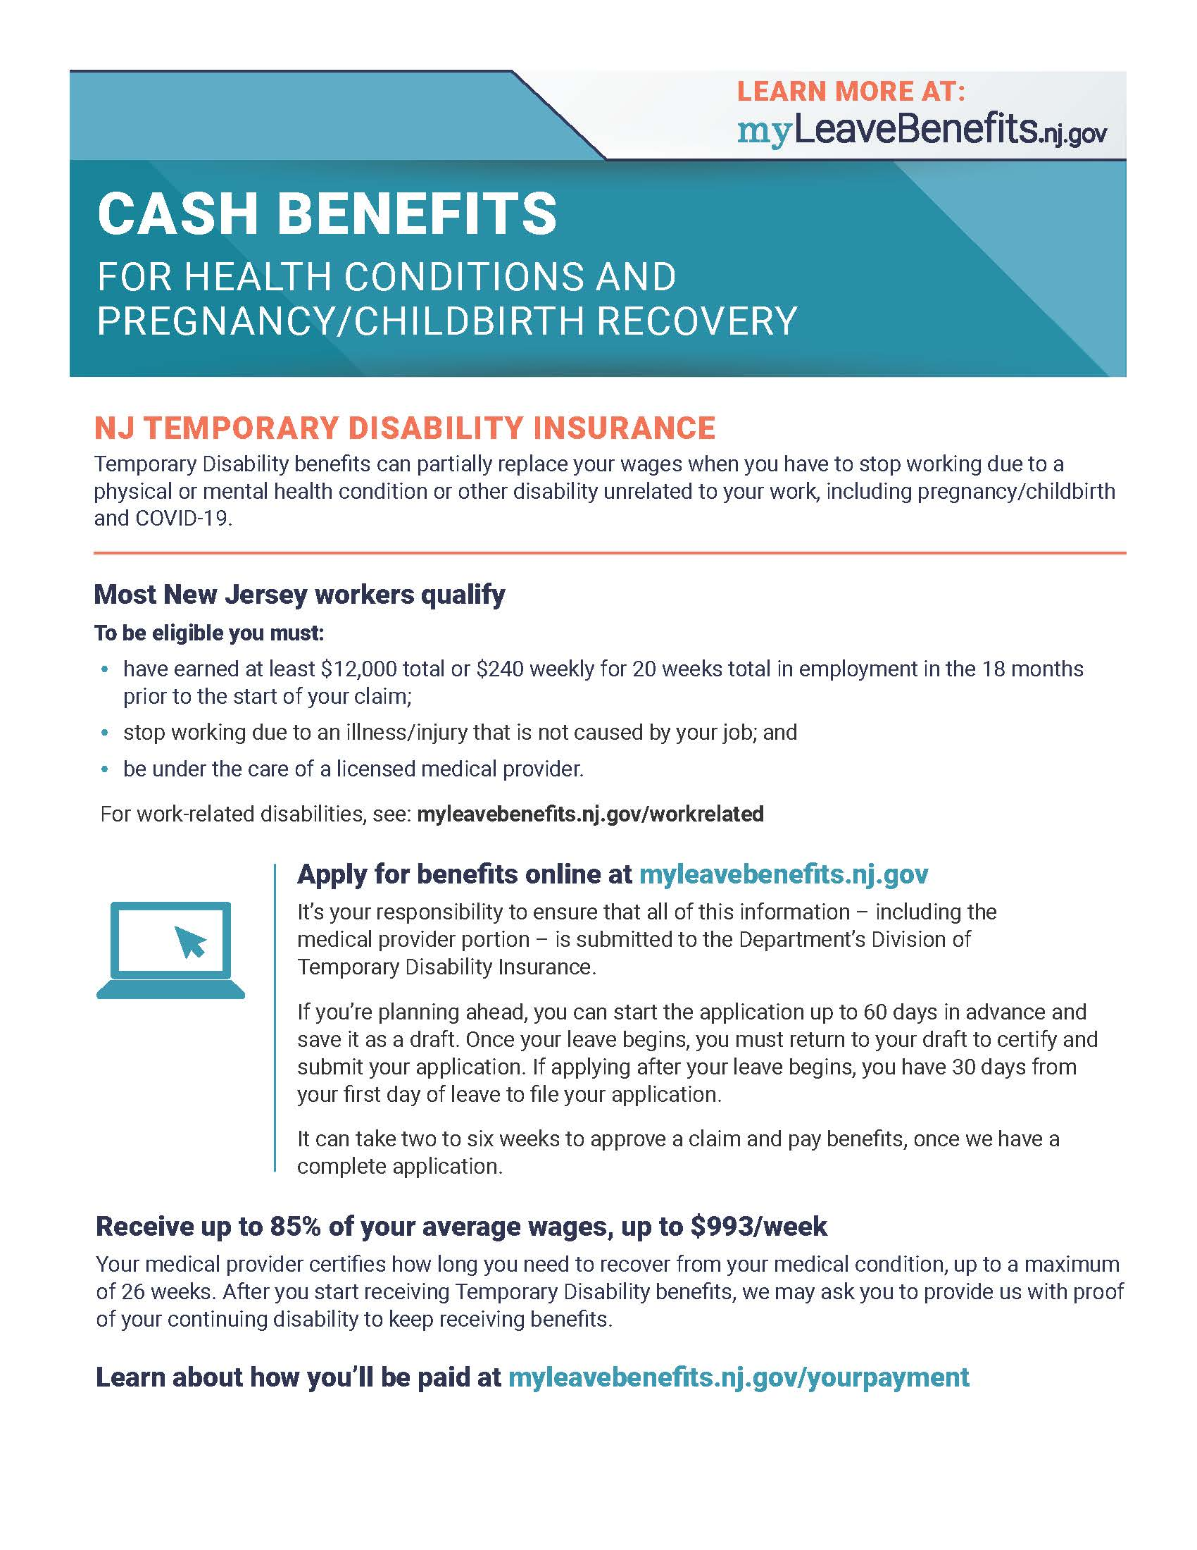
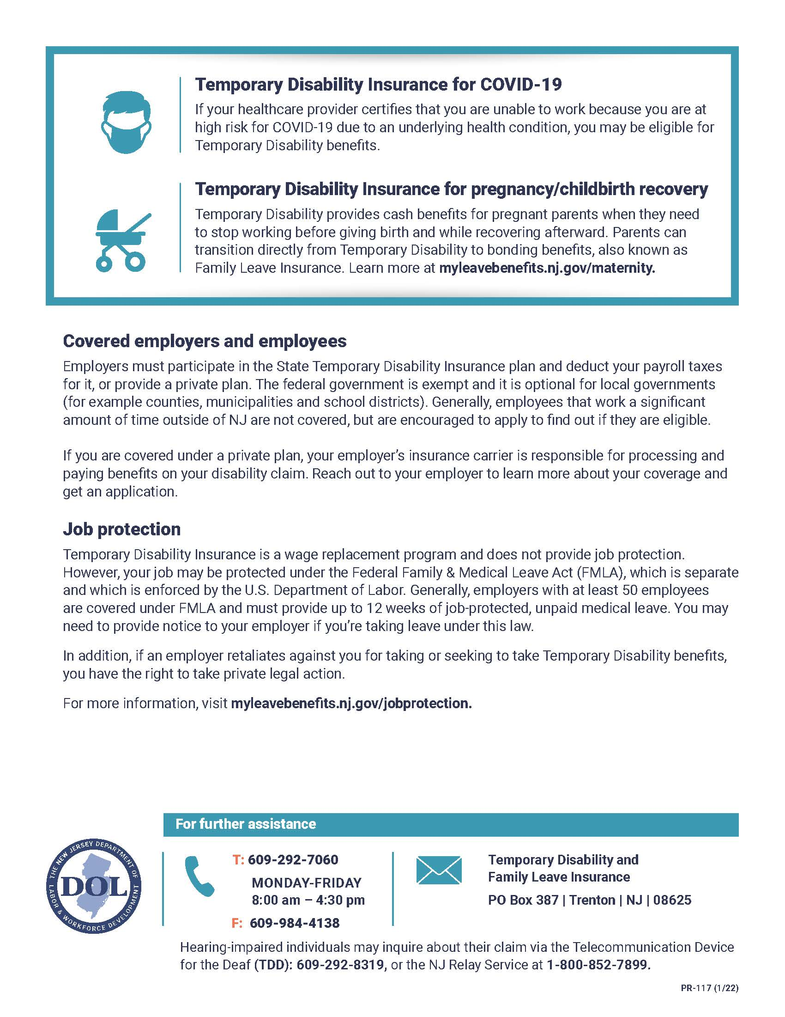

Slide 13
Wage Replacement Benefits
Workers’ Compensation: Workers' Compensation provides benefits to employees who suffer job-related injuries or illnesses.
On September 14, 2020, Governor Murphy signed Senate Bill 2380 into law, which created a rebuttable presumption of workers’ compensation coverage for COVID-19 cases contracted by “essential employees” during a public health emergency.
Applies for the period from March 9, 2020 through June 4, 2021.
If an employee deemed essential under the law contracted COVID-19, it was presumed that “the contraction of the disease is work-related and fully compensable.”
An employer can attempt to dispute this presumption.

Slide 14
If an employee needs to be absent due to school or day care closure, or need to care for family member with COVID:
May be eligible for up to 12 weeks of job-protected leave under the NJ Family Leave Act and compensation replacement under NJ Family Insurance:
If caring for a family member who has the coronavirus or symptoms of COVID-19, an additional claim may be filed at myleavebenefits.nj.gov for wage replacement.
The family member's health care provider provides the diagnosis and the expected length of time the caregiver needs to be out of work. Wage records available to NJDOL determine the amount of benefits.
It is against the law for employers to retaliate against employees for taking or seeking to take Family Leave benefits.
Many NJ workers are eligible for job-protected family leave under the NJFLA.

Slide 15
When can employees return to work?
If test positive for COVID-19 (regardless of vaccination status):
Stay home and isolate for at least 5 days.
If no symptoms or symptoms are resolving after 5 days, can leave house but should continue to wear a mask around others for 5 additional days, avoid travel if possible, and avoid places where can't wear a mask like a restaurant.
If you can't wear a mask, you should isolate for a full 10 days.
If fever, continue to stay home until fever-free for 24 hours without the use of fever-reducing medication and other symptoms improve.

Slide 16
When can employees return to work?
If exposed to COVID-19- close contact (within 6 feet for 15 minutes or more over 24-hours) with someone who had COVID-19, or if participated in a high risk activity such as attending large gatherings with people who may be unvaccinated:
IF received all recommended COVID-19 vaccine doses (received a booster dose, completed the two-dose series of Pfizer or Moderna within the past 5 months, or have received your single shot of J&J vaccine within the last 2 months), OR if under 18 but fully vaccinated (completed the two-dose series of Pfizer), OR if recovered from COVID-19 in the past 3 months:
You do not need to quarantine. But you should wear a well-fitted mask around others for 10 days and get tested at least 5 days after the exposure (recently recovered persons do not need to test).
If symptoms occur, or if you test positive, you should immediately isolate for at least 5 days after the date when symptoms began or the date of the positive test result.

Slide 17
When can employees return to work?
If have NOT received all recommended COVID-19 vaccine doses (unvaccinated, haven't completed a primary vaccine series, or are 18 or older and more than 5 months out from your second Pfizer or Moderna dose, or more than 2 months out from your J&J vaccine dose but haven't received a booster dose):
Stay home and quarantine for 5 days, monitor for symptoms, and get tested at least 5 days after exposure.
After ending quarantine, for 5 additional days, you should wear a mask around others, delay travel, avoid persons at high-risk for severe illness, and avoid places where you can't wear a mask.
If you are unable to wear a mask when around others, you should continue to quarantine for a full 10 days.
If symptoms occur, you should immediately isolate until a negative test confirms symptoms are not attributable to COVID-19.
If you test positive for COVID-19, you should isolate for 5 days from the date of the positive test result.

Slide 18
Policies
Require employees to report exposure and/or positive test
OK to share positive tests without identifying names
Set policy for when not permitted in office- quarantine
Ensure no discrimination or retaliation

Slide 19
Vaccinations
The U.S. Department of Labor’s Occupational Safety and Health Administration (OSHA) withdrew the vaccination and testing emergency temporary standard (ETS) issued on Nov. 5, 2021, to protect unvaccinated employees of large employers with 100 or more employees from workplace exposure to coronavirus. The withdrawal was effective January 26, 2022.
Although OSHA is withdrawing the vaccination and testing ETS as an enforceable emergency temporary standard, the agency is not withdrawing the ETS as a proposed rule. The agency is prioritizing its resources to focus on finalizing a permanent COVID-19 Healthcare Standard.
OSHA strongly encourages vaccination of workers against the continuing dangers posed by COVID-19 in the workplace.
BUT EMPLOYERS CAN STILL REQUIRE VACCINATIONS

Slide 20
Asking if Employees are Vaccinated
Employers are allowed to ask for proof of vaccination
Confidential health information must be kept separately from general personnel files.
Must remain confidential and is not shared with others
HIPAA does not prevent asking if an employee or a visitor has been vaccinated and to provide proof of the vaccine.

Slide 21
Acceptable proof of vaccination status
The record of immunization from a health care provider or pharmacy;
A copy of the COVID-19 Vaccination Record Card;
A copy of medical records documenting the vaccination;
A copy of immunization records from a public health, state, or tribal immunization information system; or
A copy of any other official documentation that contains the type of vaccine administered, date(s) of administration, and the name of the health care professional(s) or clinic site(s) administering the vaccine(s).
Proof of vaccination generally should include the employee’s name, the type of vaccine administered, the date(s) of administration, and the name of the health care professional(s) or clinic site(s) that administered the vaccine.

Slide 22
Acceptable proof of vaccination status
If an employee is unable to produce one of these acceptable forms of proof of vaccination, despite attempts to do so (e.g., by trying to contact the vaccine administrator or state health department), the employee can provide a signed and dated statement attesting to their vaccination status:
“I declare (or certify, verify, or state) that this statement about my vaccination status is true and accurate. I understand that knowingly providing false information regarding my vaccination status on this form may subject me to criminal penalties.”
An employee who attests to their vaccination status in this way should to the best of their recollection, include in their attestation the type of vaccine administered, the date(s) of administration, and the name of the health care professional(s) or clinic site(s) administering the vaccine.

Slide 23
Mandatory Vaccine/Testing Policy
Employers can implement a mandatory vaccination or testing policy.
State and federal requirements do not affect and employer’s ability to impose a stricter than the law vaccination or testing requirement.
Can include testing.
May exempt certain employees- those who do not report to a workplace where other individuals (such as coworkers or customers) are present; employees while working from home; or employees who work exclusively outdoors
Employers can offer an incentive to employees to get vaccinated.
Not too much though- cannot be so substantial it is coercive.
Both must be consistent and non-discriminatory in execution.

Slide 24
Executive Order Number 283
Requires workers at New Jersey healthcare facilities and high-risk congregate settings to be fully vaccinated by specific dates.
Failure to follow policy could result in disciplinary actions.
As of January 19, 2022, healthcare workers in these settings will no longer be permitted to submit to testing as an alternative to full vaccination.

Slide 25
Workers Required to be Fully Vaccinated or get COVID Tested Once a Week
Health care facilities and high-risk congregate settings
Preschool through Grade 12 schools
State agencies, authorities, colleges, and universities
Child care facilities
Both Rapid and PCR Tests are acceptable for weekly testing.

Slide 26
Handling Medical and Religious Exemptions
Exempting any employee from a vaccine mandate for religious or medical reasons requires an interactive process.
Process determines if a reasonable accommodation can be granted and the terms of said accommodation.
Must consider each exemption request individually and avoid a one-size-fits-all approach.

Slide 27
Religious Exemptions
For seeking religious exemptions in the workplace, the key word is “SINCERE”.
The EEOC stated that although “sincerity” is rarely an issue, factors may undermine the employee’s credibility:
Behaves inconsistently to a professed belief.
Sought out for a particularly desirable benefit for secular reasons.
The timing of request is suspect (i.e. followed by earlier request for the same benefit for secular reasons).
Employer has suspicion it is being sought out for non-religious reasons.

Slide 28
Medical Exemption
The only realistic medical reason is a severe allergy to a component/ingredient or the vaccine.
Previous exposure to COVID-19 does not medically exempt from being able to receive the vaccine.
If the exemption is anything other than an allergic reaction, you should require addition supporting documentation.

Slide 29
What can employers do about employees who refuse to comply with a mandatory vaccination or mask policies?
Consider accommodations,
Discipline, and/or
Terminate.
Have a clear policy and implement it uniformly and consistently.

Slide 30
Join US For the Next Webinar in our 2022 Employment Series
Employment Challenges with Employees Working Remotely on Thursday, April 7, 2022

Slide 31
Connect with Laddey, Clark and Ryan, LLP
Like us Connect with us Follow us

